Slide 1
18CSC304J COMPILER DESIGN
UNIT 4
SESSION 7

Slide 2
Topics that will be covered
Backpatching
Procedure Calls
Code Generation

Slide 3
BACKPATCHING

Slide 4
What is Backpatching?
The easiest way to implement the syntax-directed definitions for Boolean expressions is to use two passes:
Construct a syntax tree for the input
Walk the tree in depth-first order, computing the translations given in the definition
The problem to implement this in a singe pass is that during one single pass, we may not know the labels that control must go to
This problem can be solved by generating a series of branching statements with their targets temporarily left unspecified
Each such statement will be put on a list and the labels will be filled when the proper label is determined
This method is called backpatching

Slide 5
What is Backpatching? – cont..
Quadruples are generated into a quadruple array
Labels are indices into this array
Three functions are used to manipulate lists of labels:
makelist(i) – Creates a new list containing only i, an index into the array of quadruples; it returns a pointer to the list
merge(p1,p2) – Concatenates the list pointed to by p1 and p2, and returns a pointer to the concatenated list
backpatch(p,i) – Inserts i as the target label for each of the statements on the list pointed to by p

Slide 6
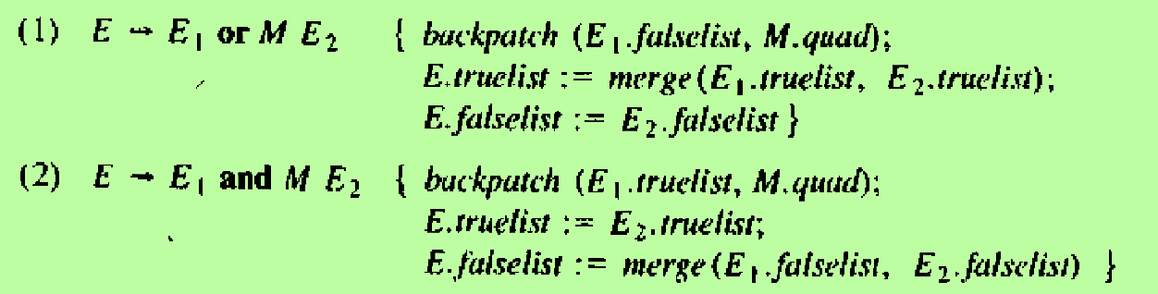
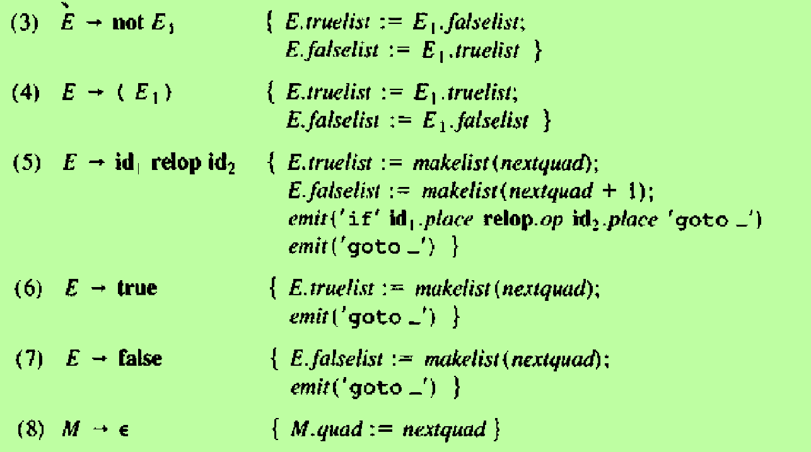
Backpatching in the Translation Scheme for Boolean Expressions
The attributes ‘truelist’ and ‘falselist’ are used to generate jumping code for Boolean expressions. When code is generated for E. jumps to the true and false exits are left incomplete, with the label field unfilled. These incomplete jumps are placed on lists pointed to be E.truelist and E.falselist as appropriate
M is a marker non-terminal and M.quad records the number of the statement where we should jump
The variable nextquad holds the index of the next quadruple to follow. This value will be backpatched onto the lists truelist and falselist as applicable

Slide 7
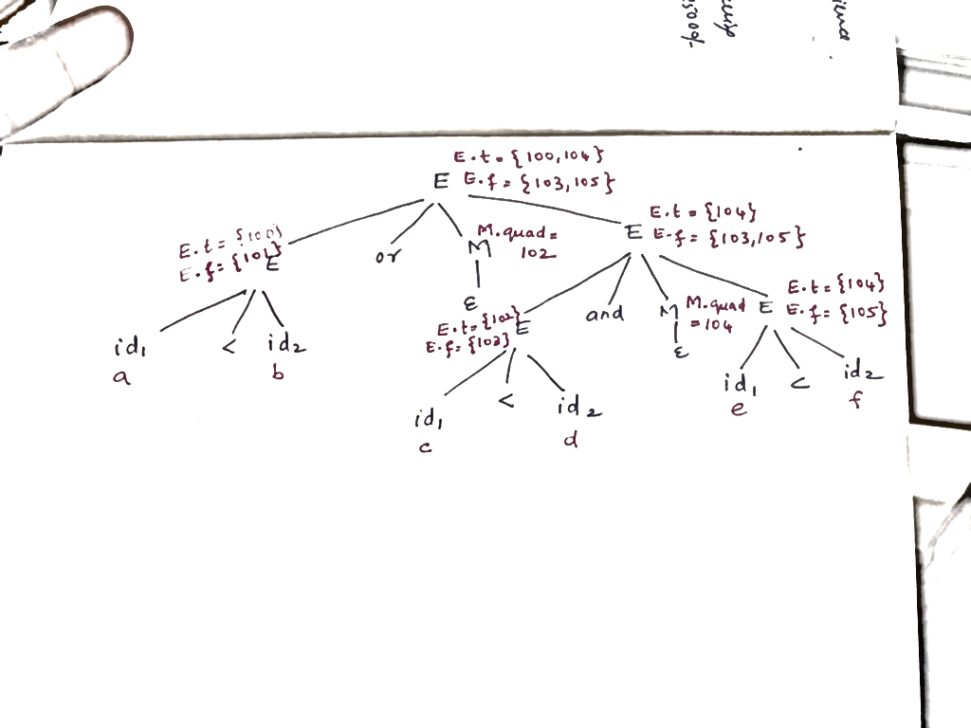
Annotated parse tree for
a<b or c<d and e<f
Three address code:
100 : if a<b goto ______
101 : goto ______
102 : if c<d goto _____
103 : goto _____
104 : if e<f goto _____
105 : goto _____
Note : The goto’s in statements 100, 103, 104 and 105 will get filled later in the compilation process

Slide 8
Backpatching in the Translation Scheme for Flow of Control Statements
Backpatching can be used to translate flow-of-control statements in one pass
Consider the grammar
S → if E then S |
if E then S1 else S2 |
while E do S |
begin L end |
A
L → L ; S | S
where
S denotes a statement
L denotes a statement list
A denotes an assignment statement
E denotes a Boolean expression

Slide 9
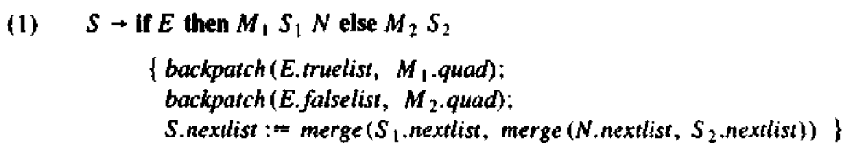
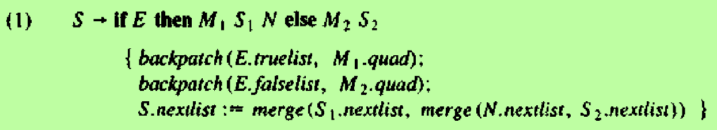
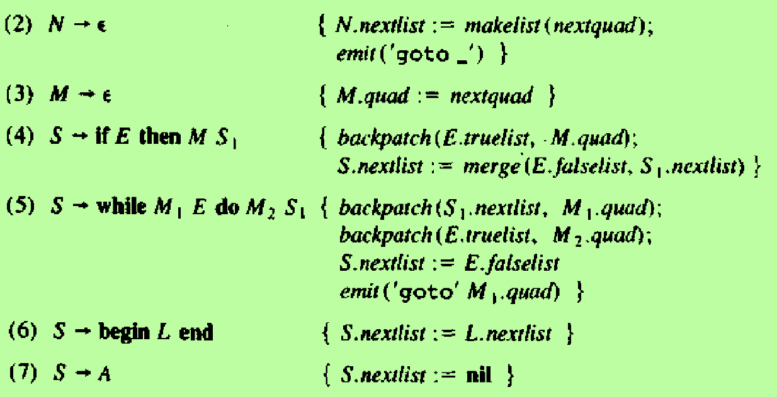
Backpatching in the Translation Scheme for Flow of Control Statements – cont..
When E is true, the jumps are backpatched to M.quad, which is the beginning of the code for S1
When E is false, the jumps are backpatched to go the beginning of the code for S2
L.nextlist and S.nextlist are the lists of unfilled quadruples that must be completed by backpatching
The list S.nextlist includes all jumps out of S1 and S2, as well as the jump generated by N
The nonterminal E has 2 attributes E.truelist and E.falselist
The marker nonterminal M has an attribute M.quad

Slide 10
PROCEDURE CALLS

Slide 11
Procedure Calls
The procedure is an important and frequently used programming construct
Consider the following grammar for a simple procedure call statement
S → callid ( Elist )
Elist → Elist , E
Elist → E

Slide 12
Calling Sequence for a Procedure Call
A calling sequence is a sequence of actions taken on entry to and exit from each procedure
The calling sequence for a procedure call is
Space must be allocated for the activation record of the called procedure
The arguments of the called procedure must be evaluated and made available to the called procedure in a known place
Environment pointers must be established to enable the called procedure to access data in enclosing blocks
The state of the calling procedure must be saved, so it can resume execution after the call
Save the return address in a known place
Generate a jump to the beginning of the code for the called procedure

Slide 13
Actions during procedure return
If the called procedure is a function, the result must be stored in a known place
Restore the activation record of the calling procedure
Generate a jump to the calling procedure’s return address

Slide 14
A Simple Example
Consider an example in which parameters are passed by reference and storage is statically allocated.
In this situation, we can use the param statements themselves as placeholders for the arguments
The called procedure is passed a pointer to the first of the param statements, and can obtain pointers to any of its arguments by using the proper offset from this base pointer
When generating three address code for this type of call
Generate three-address statements needed to evaluate those arguments that are expressions other than simple names
It is followed by a list of param three-address statements, one for each argument. If we do not want to mix the argument-evaluating statements with the param statements, we shall have to save the values of all arguments in a queue, a first-in-first-out list
Generate a param statement for each item on queue

Slide 15
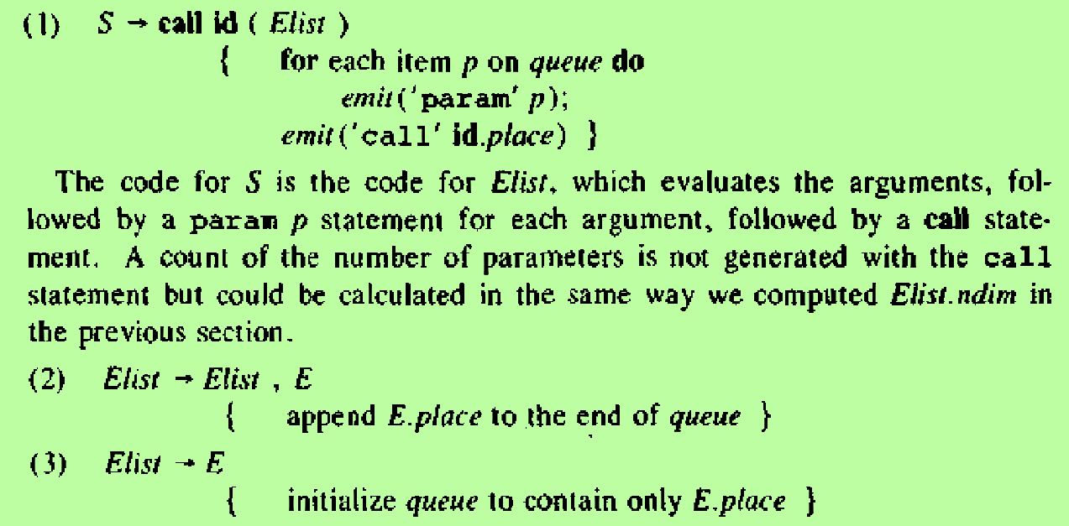
Translation Scheme for Procedure Calls
The code for S is the code for Elist, which evaluates the arguments, followed by a param p statement for each argument, followed by a call statement
Here the queue is emptied and then gets a single pointer to the symbol table location for the name that denotes the value of E

Slide 16
CODE GENERATION

Slide 17
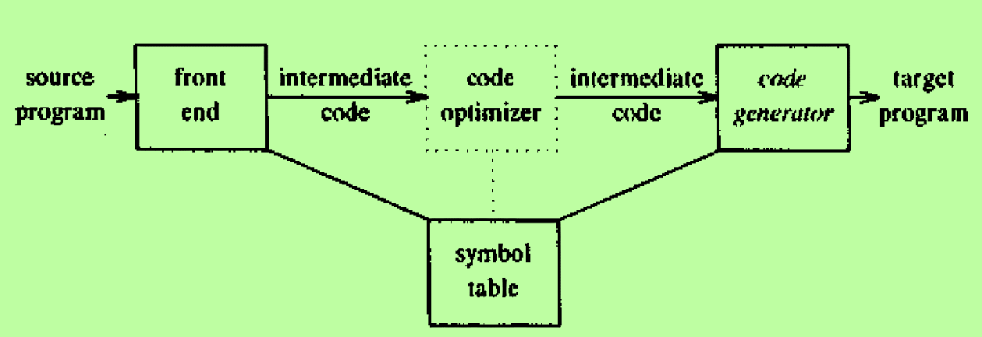
Code Generation
The final phase in our compiler model is the code generator
It takes as input an intermediate representation of the source program and produces as output an equivalent target program
The code generation techniques we are going to learn can be used whether or not an optimization phase occurs before code generation
Such a phase tries to transform the intermediate code into a form, from which more efficient target code can be produced

Slide 18
Code Generator – cont..
Requirements of a Code Generator
The output code must be correct and of high quality, meaning that it should make effective use of the resources of the target machine
The code generator itself should run efficiently
Generating Optimal Code
Mathematically, the problem of generating optimal code is undecidable
In practice, we must be content with heuristic techniques that generate good, but not necessarily optimal, code
The choice of heuristics is important, in that, a carefully designed code generation algorithm can easily produce code that is several times faster than that produced by a hastily conceived algorithm

